Slide 1

Considerations and Recommendations for Prescribing Exercise and Designing Physical Activity Programs for People with Disabilities
Expert Consensus Statement for the American College of Sports Medicine

Slide 2

Background
What Is Physical Activity?
Any movement generated by skeletal muscles that requires energy above a resting level.

Slide 3

Meeting the Physical
Activity Guidelines is More Challenging for People with Disabilities

Slide 4

Consensus
Consensus From Research Evidence
Most research has taken place in people with physical or developmental disabilities that affect movement or neurological development. The panel’s recommendations for prescribing exercise and designing physical activity programs reflect the available evidence and includes:
For many people with disabilities, a suitable dose of physical activity may be less than 150 min per week of MVPA
A tailored approach is needed for recommending and prescribing physical activity for people with disabilities
Physical activity prescriptions and programs must account for and mitigate these barriers to promote meaningful, quality participation of people with disabilities

Slide 5
Physiological Responses to Exercise Make it More Difficult to Participate

Slide 6
Were the Physical Activity Guidelines Designed for People with Disabilities?

Slide 7

Recommendations
Practical Recommendations
Based on these consensus statements, five practical recommendations are provided for prescribing and designing physical activity programs for adults with physical or developmental disabilities.
Focus on Moving More
Identify and Remove Barriers
Take an Individualized Approach
Recognize and Eliminate Ableism
Account for Physiological Variability

Slide 8
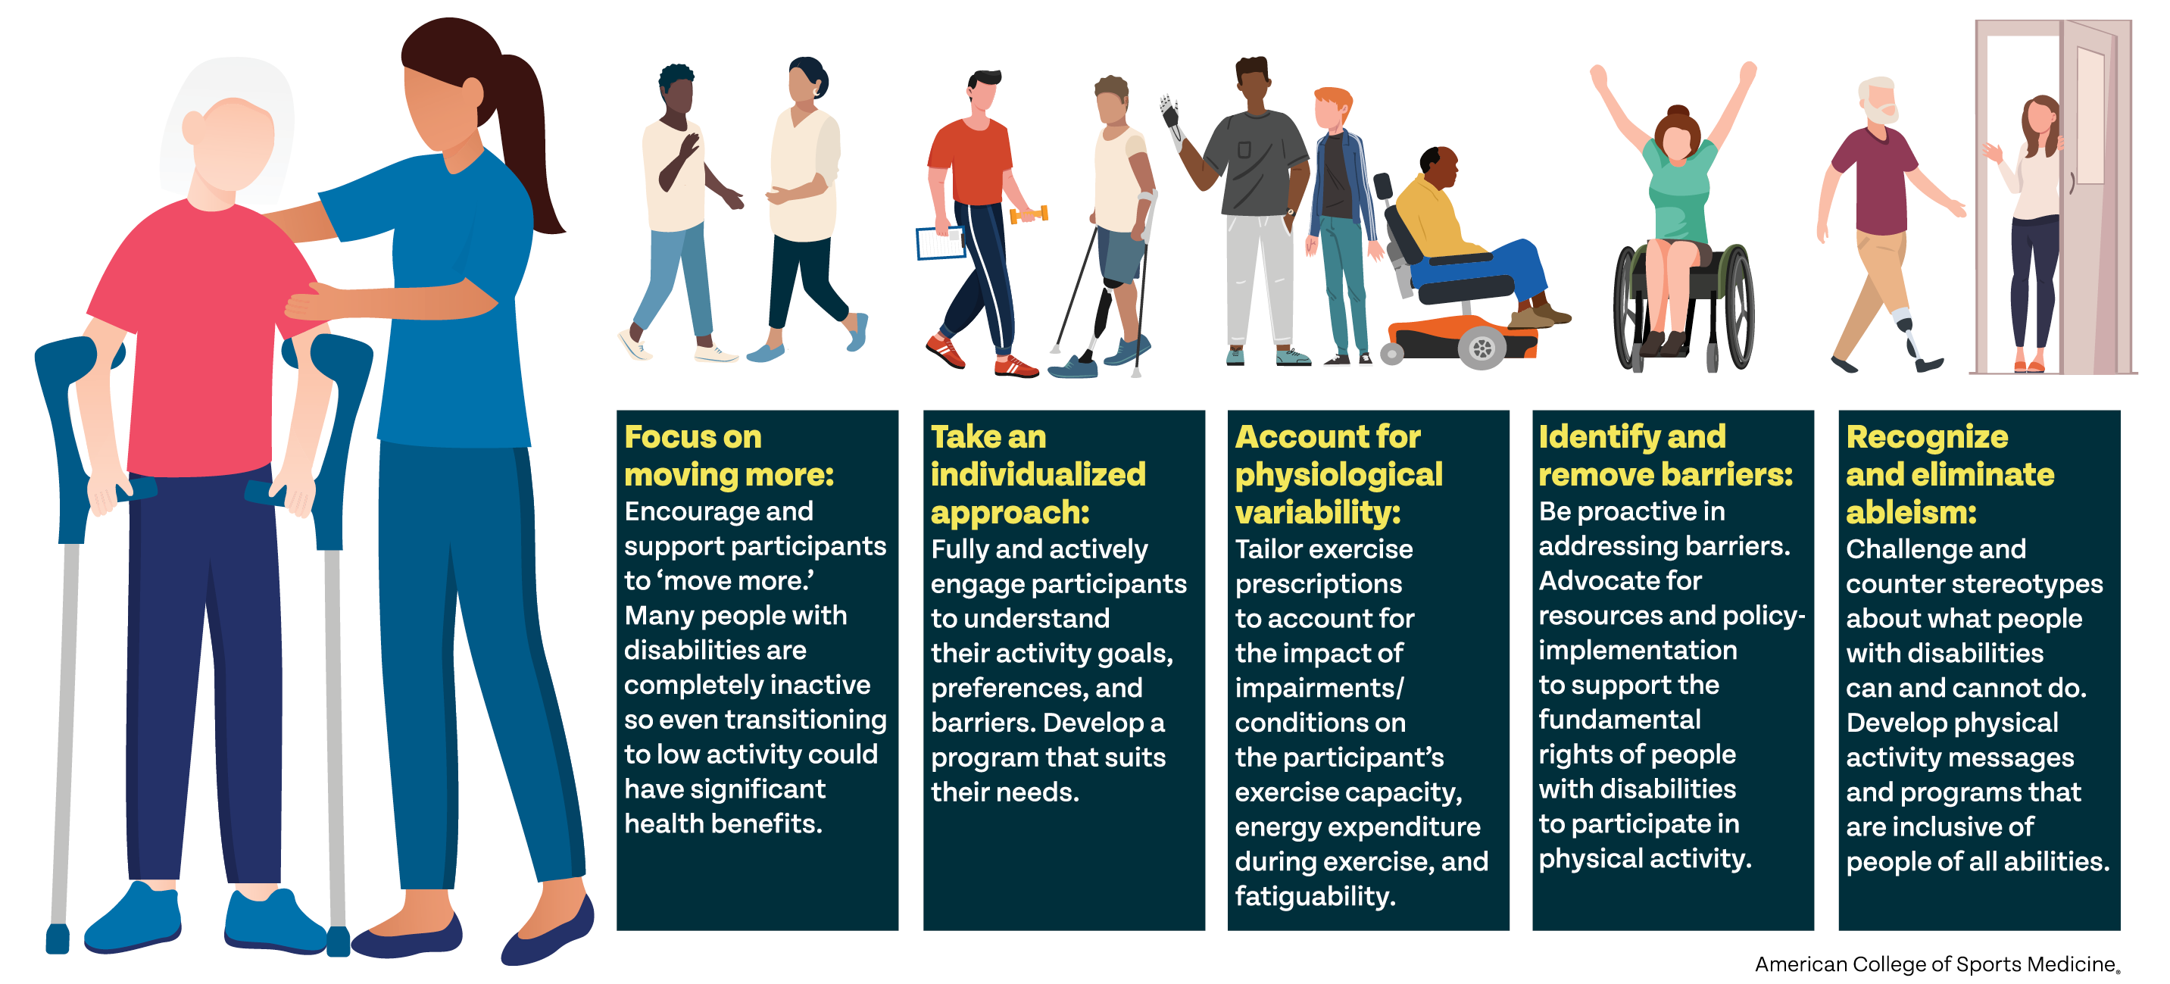
Practical Recommendations for Prescribing Exercise and Designing Physical Activity Programs for Adults with Physical or Developmental Disabilities

Slide 9
Resources for Adapting Physical Activity Programs for People with Disabilities

Slide 10
Guidance for Positive Interactions
Respecting Identity & Preferences
Recognizing Individuality
Ask if the individual prefers person-first or identity-first language and their activity preferences.
Understand that every individual has different ways of managing and living with their disability.
Learning & Understanding
Communication & Structure
Educate yourself on the person’s disability and discuss needs and wants with the individual.
Develop routines to keep a consistent structure, adopting different communication methods for individuals with diverse needs.
Creating a Supportive Environment
Create a safe space that allows the person to share information, developing patience and remaining supportive of the individual’s progression.

Slide 11
Acknowledgements
This slide deck was created by the ACSM Evidence Base Practice Committee in collaboration with the authors.
Authors
Kathleen A. Marin Ginis, PhD
Stephanie Tow, MD
Kerri Morgan, PhD
Cheri A. Blauwet, MD
Benajmin D. Boudreaux, PhD
Bo Fernhall, PhD
Janet Hauck, PhD
David Legg, PhD
Lauren Ptomey, PhD
EBP Committee
Brian Andonian, M.D.
Christian E. Behrens, Jr., Ph.D.
Chris Connolly, Ph.D., FACSM.
Christina Anne Day, M.S.N
Brian Helsel, Ph.D., C.S.C.S.
Kristine Godziuk, Ph.D.
Nicole Katz, M.D.
Hayley V. MacDonald, Ph.D.
James Patrick MacDonald, M.D., M.P.H. FACSM
Terry L. Nicola, M.D., FACSM.
Dawn Podulka Coe, Ph.D., FACSM
Bridget A. Peters, D.O., Ph.D.
Adrienne Wald, Ed.D.
Laura Young, Ph.D.

