Slide 1

Physical Activity and Exercise Intensity Terminology
A Joint American College of Sports Medicine (ACSM) Expert Statement and Exercise and Sport Science Australia (ESSA) Consensus Statement

Slide 2

PURPOSE OF STATEMENT
Problem
There is widespread inconsistent use of terminology regarding physical activity and exercise intensity. This has hampered research efforts over the years and likely limited the adoption of physical activity recommendations.
Purpose
This statement was developed by an international group of researchers and practitioners from the American College of Sports Medicine (ACSM) and Exercise and Sports Science Australia (ESSA) representatives for the purpose of proposing standardizing physical activity and exercise terminology for utility across all ages, sexes, genders, physical abilities, conditions, applications, and activities.

Slide 3

BACKGROUND
The evidence for physical activity and exercise health benefits is overwhelming and irrefutable^{1,2}
Training principles are regularly utilized to enhance health and prevent disease
General physical activity recommendations have been developed by various organizations
These appear similar in direction, but inconsistent in definitions and criteria
Personalized exercise prescriptions are often needed to guide individuals in becoming more active in a healthy and habitual way³
This is challenging without standardized, commonly-accepted exercise terminology

Slide 4

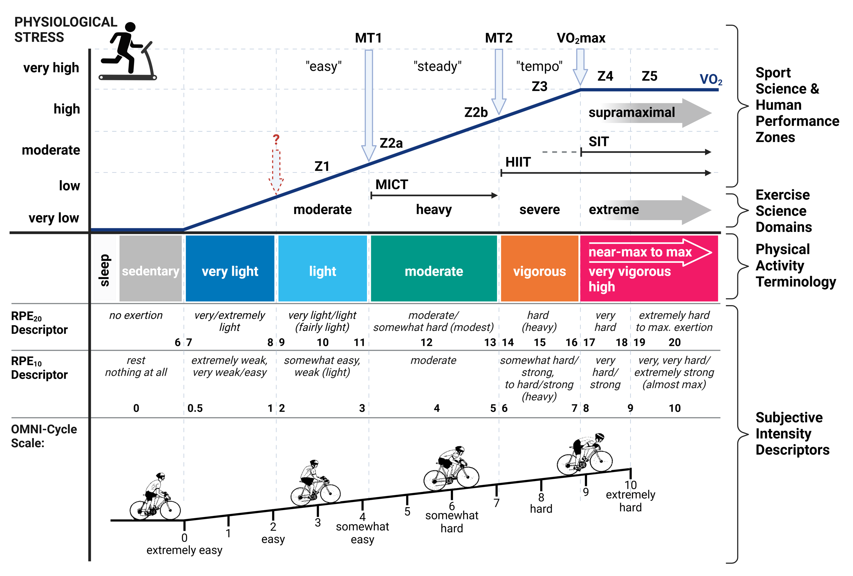
Inconsistencies in some of the many terms used by researchers, practitioners, and leading agencies to categorise (in)activity and exercise intensity.
ILLUSTRATION OF PROBLEM

Slide 5
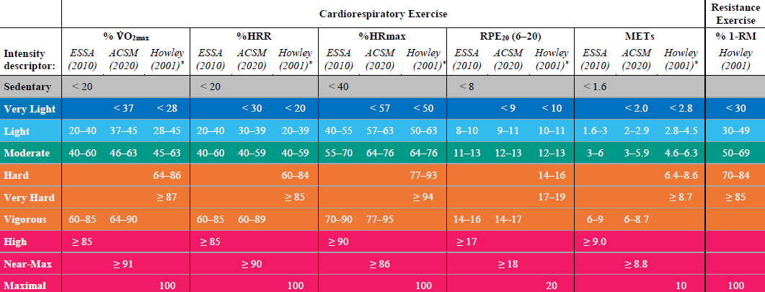
ILLUSTRATION OF PROBLEM
Discrepancies with current descriptors and criteria to estimate activity/exercise intensity*
*Based on the Exercise and Sport Science Australia (ESSA) position statement ACSM’s Guidelines for Exercise Testing and Prescription ^{7-9,} and Howley¹⁰

Slide 6
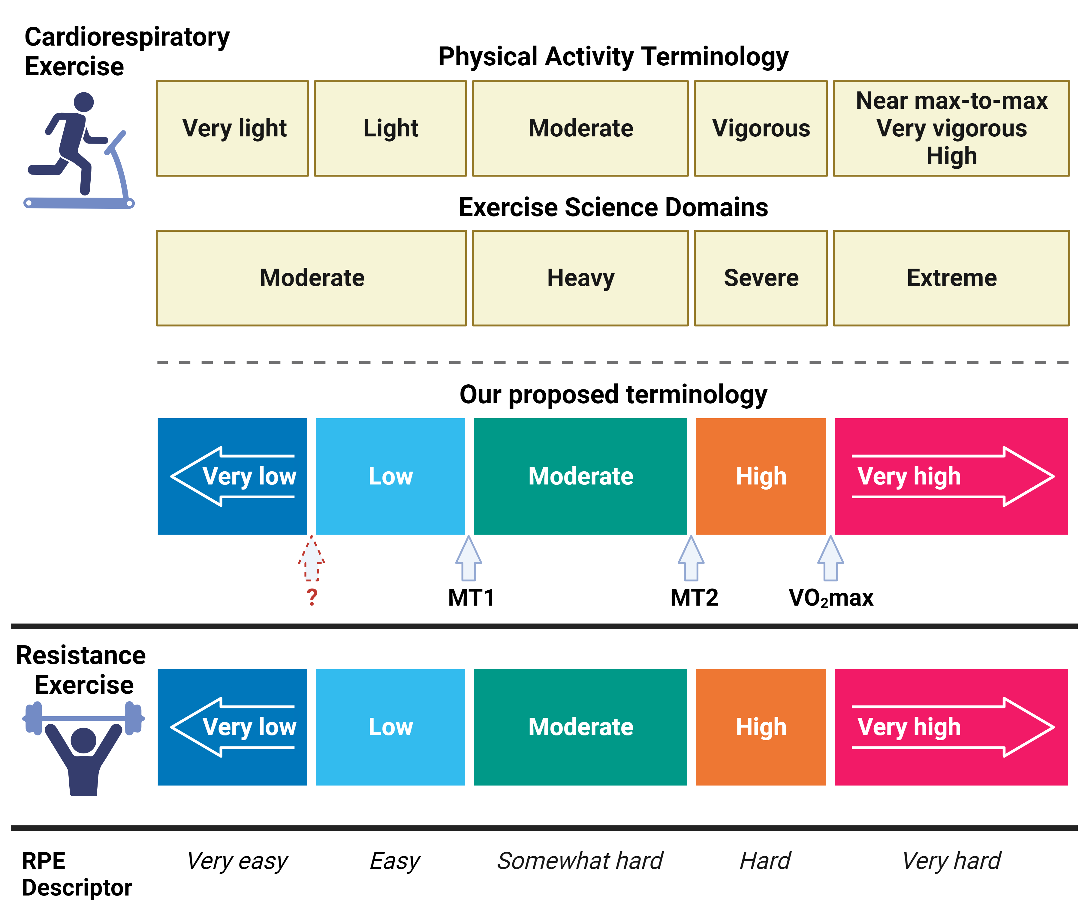
PROPOSED TERMINOLOGY

Slide 7
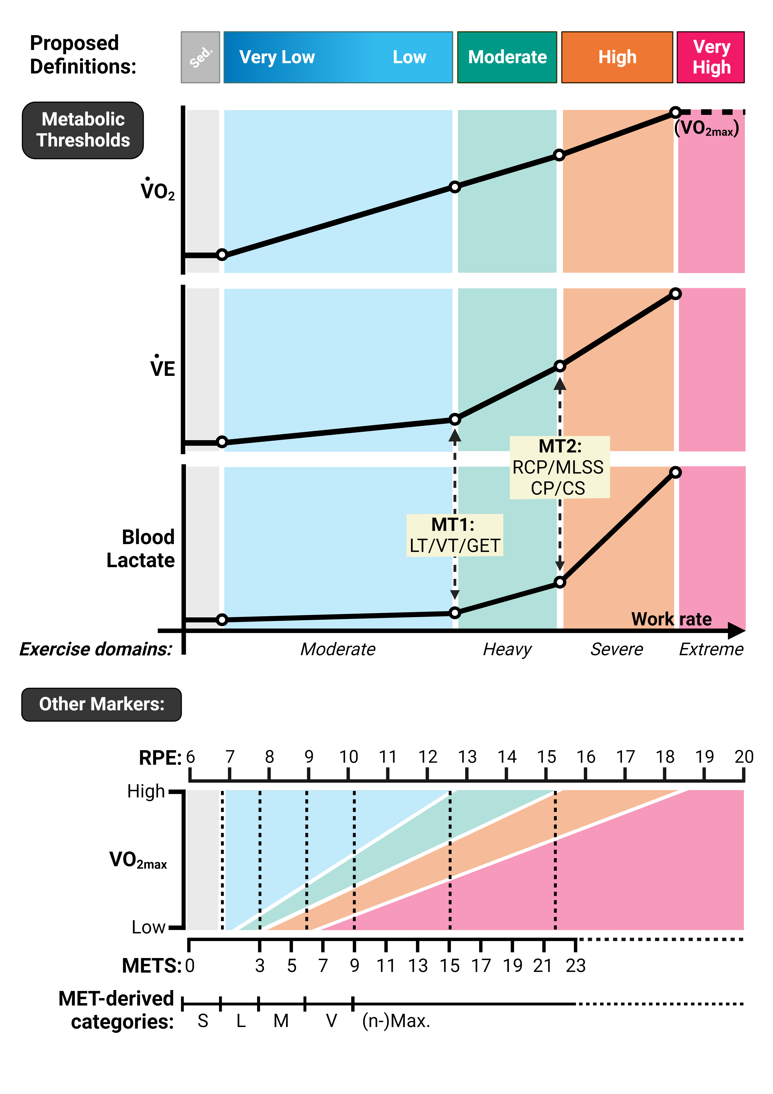
PROPOSED MARKERS OF INTENSITY

Slide 8
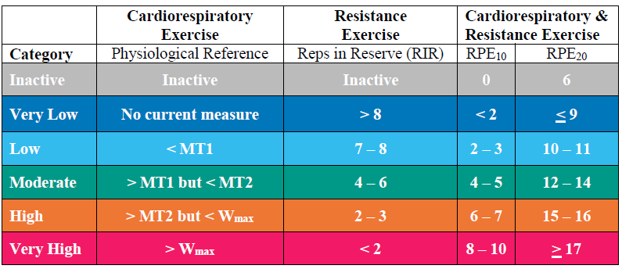
PROPOSED CRITERIA
FOR CLASSIFICATIONS
To estimate physical activity intensity for all training categories

Slide 9

SUMMARY
This expert statement suggests clinical approaches to determine and monitor exercise and physical activity intensity.
Cardiorespiratory Exercise Intensity:
Metabolic Thresholds (lactate threshold, gas exchange threshold, ventilatory threshold)
Perceptual Measures (Rating of Perceived Exertion (RPE))
Resistance Exercise Intensity:
Estimation of Proximity to Neuromuscular Failure (Repetitions in Reserve (RIR))
Perceptual Measures (Rating of Perceived Exertion (RPE))

Slide 10
SUMMARY
This expert statement builds on previous literature and proposes a standard framework for describing and prescribing exercise intensity across different disciplines and fields.
A standard terminology is proposed for physical activity, exercise, and sport and human performance, applicable to both cardiorespiratory and resistance
Exercise that consists of:
Five exercise intensities:
Very Low, Low, Moderate, High, and Very High
→ Five descriptors for the corresponding perception of effort:
Very easy, Easy, Somewhat hard, Hard, and Very hard

Slide 11

References
1. Piercy KL, Troiano RP, Ballard RM, et al. The Physical Activity Guidelines for Americans. JAMA. 2018;320(19):2020-8.
2. DiPietro L, Buchner DM, Marquez DX, Pate RR, Pescatello LS, Whitt-Glover MC. New
635 scientific basis for the 2018 US Physical Activity Guidelines. J Sport Health Sci. 2019;8(3):197-200.
3. Pedersen BK, Saltin B. Evidence for prescribing exercise as therapy in chronic disease. Scand J Med Sci Sports. 2006;16 Suppl 1:3-63.
4. Powers SK, Howley ET. Exercise Physiology: Theory and Application to Fitness and Performance. third ed. Chicago: Brown & Benchmark; 1997.
5. Ratamess N. ACSM's foundations of strength training and conditioning. Lippincott Williams & Wilkins; 2012.
6. Pedersen BK, Saltin B. Evidence for prescribing exercise as therapy in chronic disease. Scand J Med Sci Sports. 2006;16 Suppl 1:3-63.
7. ACSM. Guidelines for Graded Exercise Testing and Exercise Prescription. Lea & Febiger Philadelphia, PA; 1975.
8. ACSM's guidelines for exercise testing and prescription. 11 ed.: Lippincott Williams & Wilkins; 2020.
9. Thompson W, Gordon N, Pescatello L. ACSM’s guidelines for exercise testing and prescription. Chicago, IL.: Lippincott Williams & Wilkins.; 2009.
10. Howley ET. Type of activity: 768 resistance, aerobic and leisure versus occupational physical activity. Med Sci Sports Exerc. 2001;33(6 Suppl):S364-9; discussion S419-20.

Slide 12
Acknowledgements
This slide deck was created by members of the ACSM Evidence Based Practice Committee in partnership with the authors.
Authors
David J. Bishop
Belinda Beck
Stuart J. H. Biddle
Keri L. Denay
Alessandra Ferri
Martin J. Gibala
Samuel Headley
Andrew M. Jones
Mary Jung
Matthew J.-C. Lee
Trine Moholdt
Robert U. Newton
Sophia Nimphius
Linda S. Pescatello
Nicholas J. Saner
Chris Tzarimas
EBP Committee
Brian Andonian, M.D.
Christian E. Behrens, Jr., Ph.D.
Chris Connolly, Ph.D., FACSM.
Christina Anne Day, M.S.N
Brian Helsel, Ph.D., C.S.C.S.
Kristine Godziuk, Ph.D.
Nicole Katz, M.D.
Hayley V. MacDonald, Ph.D.
James Patrick MacDonald, M.D., M.P.H. FACSM
Terry L. Nicola, M.D., FACSM.
Dawn Podulka Coe, Ph.D., FACSM
Bridget A. Peters, D.O., Ph.D.
Adrienne Wald, Ed.D.
Laura Young, Ph.D.

