Slide 1

Blood Doping in Sport
Consensus Statement for the American College of Sports Medicine

Slide 2

Purpose
Red blood cell (RBC) mass directly influences exercise performance because RBCs are critical to the transport of oxygen to skeletal muscle, as well as their role in maintaining acid–base status and regulating blood flow.
Blood doping is defined as the practice of artificially increasing RBC volume for the purpose of improving exercise performance.
In the last 25 years, the science and technology surrounding oxygen sensing and erythropoiesis, pharmacological intervention, and doping detection has advanced substantially, dictating this updated review.
This statement will primarily focus on the most conventional blood doping methods such as blood transfusions and erythropoiesis-stimulating agents (ESA), how these practices has emerged over time, as well as discuss new and emerging threats.

Slide 3

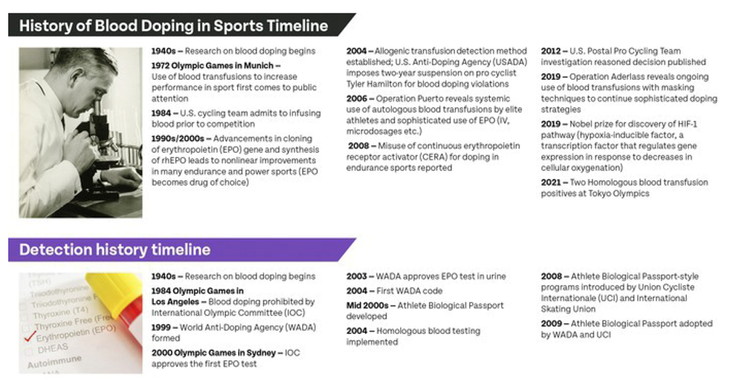
History of Blood Doping and Detection (Figure 1)
The World Anti-doping Agency was formed in 1999, providing a global authority to harmonize anti-doping policies, rules, and regulations in sport via the World Anti-doping Code.
Blood doping became a significant problem in sport with many high-profile investigations (e.g., Operation Puerto, US Postal Investigation, and Operation Aderlass).
Testing for synthetic erythropoietin (EPO) was introduced in time for the Sydney Olympic Games.
Advances in blood collection, transport, and analysis protocols facilitated the introduction of the Athlete Biological Passport blood module, providing a method for indirect detection of blood manipulation.

Slide 4
World Anti-Doping Agency (WADA) Prohibited List
WADA prohibits the use of drugs and certain methods in sport based on three criteria. For a substance or method to be prohibited, it must meet at least two out of three criteria. Blood doping fulfills all three criteria:
S2.1: Erythropoietins (EPO) and Agents Affecting Erythropoiesis | M1: (Prohibited Method) Manipulation of Blood and Blood Components | M3: (Prohibited Method) Gene and Cell Doping
Stimulate the erythropoietic pathway to increase red blood cell production | Administration or reintroduction of any quantity of autologous, allogenic (homologous) or heterologous blood, or red blood cell products of any origin into the circulatory system | Gene manipulation and stem cell modification techniques
Erythropoietin receptor agonists | Artificially enhancing the uptake, transport or delivery of oxygen. Including, but limited to: perfluorochemicals; efaproxiral (RSR13) and modified hemoglobin products, e.g., hemoglobin-based blood substitutes and microencapsulated hemoglobin products | Specifically, the use of nucleic acids or nucleic acid analogues that may alter genome sequences and/or alter gene expression by any mechanism. This includes but is not limited to gene editing, gene silencing, and gene transfer technologies, as well as the use of normal or genetically modified cells.
Hypoxia-inducible factor (HIF) activating agents | Any form of intravascular manipulation of the blood or blood components by physical or chemical means

Slide 5
Prevalence
Anti-doping testing serves as a means of both detection and deterrence. Anti-doping testing consists of both in and out-of-competition testing; therefore, not every athlete is tested at every competition, and only athletes who meet certain performance criteria are part of the anti-doping authorities’ registered testing pool for out-of-competition testing.
Much of our knowledge of blood doping in sport arises from published testimony or athlete data following official sanctions (3, 5, 6).
Data from the international cross-country ski championships suggested that ~50% of medal winners had abnormal hematologic profiles (4), but the true prevalence of doping among athletes competing at the highest level remains virtually unknown.
An anonymous survey completed in competition by World Athletics estimated overall doping prevalence (not blood doping specifically) to be between 39% and 62% (8), whereas the prevalence of blood doping in elite track-and field athletes using hematological passport data was estimated to be 15%–18% between 2011 and 2013 (9).
Recent analysis of erythropoietin receptor agonist detection trends suggests a possible deterrent effect with 43% of positive findings occurring on the first sample collected on the athlete, with positive rates declining as athletes are further tested (10).

Slide 6

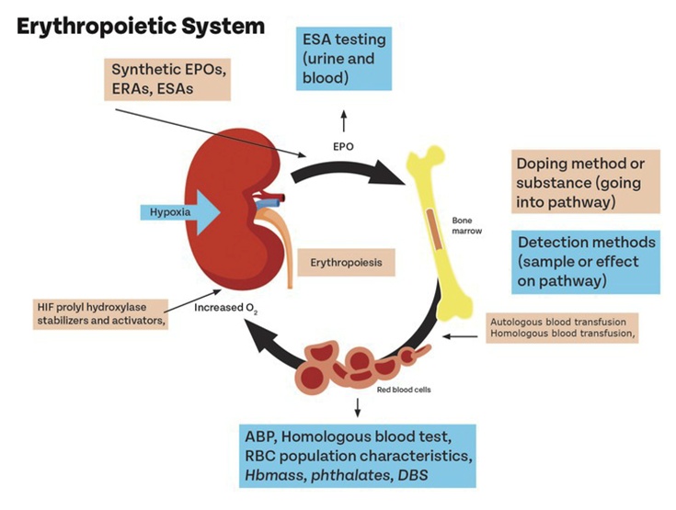
Physiology
Figure 2. Summary of erythropoietic system, highlighting areas of action by doping methods or substances (arrows going into pathway) and areas for detection (arrows going away from pathway).
Adapted from: Anemia of chronic kidney disease: Treat it, but not too aggressively. Georges Nakhoul, MD and James F. Simon, MD. Cleveland Clinic Journal of Medicine. August 2016, 83 (8) 613-624; DOI: https://doi.org/10.3949/ccjm.83a.15065

Slide 7
Hematological
The primary physiological effect of blood transfusions and recombinant human erythropoietin (rhEPO) administration is an increase in absolute numbers of red cells (Figure 2) and most easily quantified by measuring red blood cell (RBC) or hemoglobin mass (Hbmass).
Absolute values of Hbmass are influenced naturally by endurance training, altitude exposure and various disease states (iron deficiency anemia, polycythemia, blood loss).
Blood transfusion has clear and immediate effect on Hbmass.
  When blood is withdrawn, plasma volume expands rapidly to maintain total blood volume, while homeostatic recovery of Hbmass takes considerable time.
  The magnitude of Hbmass change induced from blood infusion depends on the volume of blood infused. One standard blood transfusion of packed RBCs prepared from 1 unit of whole blood contains ~60 g of Hbmass (11), resulting in an increase of 6%–7% in an individual possessing 900 g of Hbmass.
Erythropoietin (EPO) or erythropoiesis-stimulating agent administration also serves to increase Hbmass via accelerating erythropoiesis.
  The time course of the increase is more prolonged vs. infusions and closely related to the dosing regimen, as is the magnitude of the Hbmass response. For example, 4 wk of weekly EPO injections is reported to increase Hbmass by 92 g (9.6%) (13).

Slide 8
Performance
Maximal endurance performance is primarily determined by oxygen delivery to, and use by, working muscles (i.e., the Fick principle).
Therefore, alterations to hemoglobin mass (Hbmass) have the potential to significantly alter maximal aerobic capacity (VO_{2max}) by increasing arterial oxygen content.
A strong relationship exists between hemoglobin levels and VO_{2max}, with a change in absolute Hbmass of 1g associated with a change in absolute VO_{2max} of ~4 mL·min⁻¹ (12, 14) and similarly a 1 g·dL⁻¹ change in hemoglobin concentration corresponding to a 5% change in absolute VO_{2max} (15).
Marked effects of athletic performance (i.e., the ability to complete a defined task or effort to a higher standard) have also been demonstrated in research settings following blood doping techniques (17, 18), particularly those assessing endurance performance where the ability to sustain a high percentage of VO_{2max} is critical to success (19).
Indeed, it is not only competition performance that can benefit from blood doping, but also the training effect following doping, which can be augmented. For example, Buick et al. (16) showed maintenance of augmented VO_{2max} long past the life cycle of the infused red blood cells—likely due to the better training that the athletes were able to do in the blood-doped state.

Slide 9
Altitude
When considering the physiological and performance effects of blood doping, it is important to acknowledge that accelerated erythropoiesis can also be stimulated by endogenous production of erythropoietin (EPO) in response to hypoxia (20).
Adaptation to altitude has often been dubbed a “natural form of blood doping,” and altitude training routinely features in the training programs of many elite endurance athletes.
Yet, for a given hypoxic dose, both the EPO response and overall adaptive response to altitude appear highly variable between individuals (23, 24). Indeed, increases in Hbmass, maximal aerobic capacity, and performance are by no means guaranteed following altitude exposure and appear to be influenced by other factors that may modulate an individual’s ability to adapt to altitude (25).
In contrast, the resultant magnitude of change in Hbmass following blood doping and EPO administration has potential to be almost double that which can be expected via the altitude-induced EPO pathway at altitudes typically used by elite athletes.
For example, the infusion of 1–2 bags of blood (500 mL each) for doping purposes will increase hemoglobin by about 1–2 g·dL⁻¹ and hematocrit by 3%–6% (1). A typical course of erythropoiesis-stimulating agent may lead to similar changes (2). By contrast, altitude-induced changes are far more subtle and related to the overall hypoxic dose (21, 22).

Slide 10
Medical Risks/ Side Effects
Blood doping, like any medical intervention, has side effects that are different based on the technique used and exacerbated when abused by healthy individuals in uncontrolled settings.
Potential consequences of increasing red cell mass to supraphysiological levels must be differentiated from the pharmacological or procedural side effects of the abused substance.
Doping Agent or Practice | Area of Risk | Known Risks | Side Effects
Erythropoiesis-stimulating agents (ESA) | Pharmacological | Death, myocardial infarction, stroke, venous thromboembolism | Arterial hypertension, headache, pruritus, nausea
Withdrawal/ Infusion | Procedural | Contamination (of the autologous blood with bacteria or viruses), degradation due to inappropriate storage, death (allergic or septic symptoms)

Slide 11
Detection
Detection of prohibited blood doping practices has advanced and evolved substantially in the last 25 years and now includes both direct and indirect detection methods (Figure 2).
This divergence of approaches has allowed anti-doping authorities to establish anti-doping rule violations that include the presence of blood doping agents, as well as to establish use and/or attempted use violations for blood doping methods.
Testing of athletes is conducted based on no-advance notice, in or out of competition, and involves collection of biological fluids, predominantly urine or blood.
It is important to note, however, that athlete testing is not harmonized across sport or the world, and even the most advanced testing analyses are only as good as the ability and willingness to obtain well-timed samples from athletes.
To combat this, anti-doping authorities have evolved to adopt indirect detection methods to try to discourage blood doping practices. Further, research efforts are focused on changes in blood parameters to external blood manipulation, resulting in an individualized, longitudinal monitoring of biomarkers related to erythropoiesis known as the Athlete Biological Passport (26).

Slide 12
Future Perspectives/Threats
The threat of blood doping continues to evolve, as new technologies emerge. Specifically, erythropoiesis-related genes could be targeted by several different techniques.
Development of new tests for blood doping remains challenging for many reasons, including the necessity for a very high specificity (i.e., no false positives) combined with good sensitivity (i.e., minimizing false negatives). Ideally, any successful test would also have an extended time frame of detection, improve on any existing testing, and can detect multiple doping substances or methods.
Existing blood doping techniques have proven effective for some time; thus, it is likely that athletes will continue to try to exploit ways to improve their endurance performance through pharmaceutical intervention or blood doping methods.
Through the existence of more harmonized anti-doping rules, as well as the mandatory implementation of the Athlete Biological Passport across the athlete population in high-risk endurance sports and minimum levels of analysis for erythropoiesis-stimulating agents in urine and/or blood, the detection and deterrence potential across sports has greatly improved.
Increasingly individualized testing programs based on dynamic risk assessment of several risk factors has the potential to better determine when and where to effectively conduct athlete testing.

Slide 13

Conclusions/ Recommendation
It is the position of the American College of Sports Medicine (ACSM) that any blood doping procedure used to improve athletic performance is unethical and unfair and exposes the athlete to unwarranted and potentially serious health risks.
Blood doping can enhance an athlete’s oxygen-carrying capacity and improve an athlete’s ability to perform submaximal and maximal endurance efforts beyond normal training interventions, including adaption to hypoxic environments.
Since the first ACSM Position Stand 25 years ago, the science and technology surrounding erythropoiesis, pharmacological intervention, and doping detection have all advanced substantially.
As long as competitive fairness and athlete health and wellness remain fundamental components of sport governance, strong efforts need to continue in the areas of doping detection and education of athletes, coaches, and medical professionals on the risks associated with blood doping.

Slide 14

References
Pace N, Lozner EL, et al. The increase in hypoxia tolerance of normal men accompanying the polycythemia induced by transfusion of erythrocytes. Am J Physiol. 1947;148(1):152–63.
Rabin OP, Lasne F, Pascual JA, Saugy M, Delbeke FJ, Van Eenoo P. New urinary EPO drug testing method using two-dimensional gel electrophoresis. Clin Chim Acta. 2006;373(1–2):186–7
Zorzoli M. The Athlete Biological Passport from the perspective of an anti-doping organization. Clin Chem Lab Med. 2011;49(9):1423–5.
Stray-Gundersen J, Videman T, Penttila I, Lereim I. Abnormal hematologic profiles in elite crosscountry skiers: blood doping or? Clin J Sport Med. 2003;13(3):132–7.
U.S. Anti-Doping Agency. Report on proceedings under the World Anti-Doping Code and the USADA Protocol 2012. Available from: https://www.usada.org/wp-content/uploads/ReasonedDecision.pdf.
Zorzoli M, Rossi F. Case studies on ESA-doping as revealed by the Biological Passport. Drug Test Anal. 2012;4(11):854–8.
World Anti-Doping Agency. 2022 Anti-Doping Testing Figures. 2022.
Ulrich R, Pope HG Jr., Cléret L, et al. Doping in two elite athletics competitions assessed by randomized-response surveys. Sports Med. 2018;48(1):211–9.
Faiss R, Saugy J, Zollinger A, et al. Prevalence estimate of blood doping in elite track and field athletes during two major international events. Front Physiol. 2020;11:160.
Equey T, Broseus J, Baume N, Aikin R. Trends in the detection of erythropoietin receptor agonists (ERAs) in anti-doping: an analysis of recent adverse analytical findings (AAFs). Drug Test Anal. 2024. doi:10.1002/dta.3828.
Pottgiesser T, Umhau M, Ahlgrim C, Ruthardt S, Roecker K, Schumacher YO. Hb mass measurement suitable to screen for illicit autologous blood transfusions. Med Sci Sports Exerc. 2007;39(10):1748–56.
Schmidt W, Prommer N. Impact of alterations in total hemoglobin mass on VO2max. Exerc Sport Sci Rev. 2010;38(2):68–75.
Lundby C, Robach P. Assessment of total haemoglobin mass: can it detect erythropoietin-induced blood manipulations?
Eur J Appl Physiol. 2010;108(1):197–200.

Slide 15
References
Saunders PU, Garvican-Lewis LA, Schmidt WF, Gore CJ. Relationship between changes in haemoglobin mass and maximal oxygen uptake after hypoxic exposure. Br J Sports Med. 2013;47 Suppl 1(Suppl 1):i26–30.
Webb KL, Gorman EK, Morkeberg OH, et al. The relationship between hemoglobin and VO2max: a systematic review and meta-analysis. PLoS One. 2023;18(10):e0292835.
Buick FJ, Gledhill N, Froese AB, Spriet L, Meyers EC. Effect of induced erythrocythemia on aerobic work capacity. J Appl Physiol Respir Environ Exerc Physiol. 1980;48(4):636–42.
Brien AJ, Simon TL. The effects of red blood cell infusion on 10-km race time. JAMA. 1987;257(20):2761–5.
Ekblom B. Blood doping and erythropoietin. The effects of variation in hemoglobin concentration and other related factors on physical performance. Am J Sports Med. 1996;24(6 Suppl):S40–2.
Joyner MJ, Coyle EF. Endurance exercise performance: the physiology of champions. J Physiol. 2008;586(1):35–44.
Garvican L, Martin D, Quod M, Stephens B, Sassi A, Gore C. Time course of the hemoglobin mass response to natural altitude training in elite endurance cyclists. Scand J Med Sci Sports. 2012;22(1):95–103.
Garvican-Lewis LA, Sharpe K, Gore CJ. Time for a new metric for hypoxic dose? J Appl Physiol (1985). 2016;121(1):352–5.
Lobigs LM, Sharpe K, Garvican-Lewis LA, et al. The athlete's hematological response to hypoxia: a meta-analysis on the influence of altitude exposure on key biomarkers of erythropoiesis. Am J Hematol. 2018;93(1):74–83.
Chapman RF, Stray-Gundersen J, Levine BD. Individual variation in response to altitude training. J Appl Physiol (1985). 1998;85(4):1448–56.
Garvican LA, Martin DT, Clark SA, Schmidt WF, Gore CJ. Variability of erythropoietin response to sleeping at simulated altitude: a cycling case study. Int J Sports Physiol Perform. 2007;2(3):327–31.
Saunders PU, Garvican-Lewis LA, Chapman RF, Periard JD. Special environments: altitude and heat. Int J Sport Nutr Exerc Metab. 2019;29(2):210–9.
Sottas PE, Robinson N, Rabin O, Saugy M. The athlete biological passport. Clin Chem. 2011;57(7):969–76.

Slide 16
Acknowledgements
This slide deck was created by members of the ACSM Evidence Based Practice Committee in partnership with the authors.
Committee members: Hayley V. MacDonald, Ph.D.
  Brian Andonian, M.D.
  Christian E. Behrens, Jr., Ph.D.
  Chris Connolly, Ph.D., FACSM
  Christina Anne Day, M.S.N.
  Brian Helsel, Ph.D., C.S.C.S.
  Kristine Godziuk, Ph.D.
  Nicole Katz, M.D.
  James Patrick MacDonald, M.D., M.P.H., FACSM
  Terry L. Nicola, M.D., FACSM
  Dawn Podulka Coe, Ph.D., FACSM
  Bridget A. Peters, D.O., Ph.D.
  Adrienne Wald, Ed.D.
  Laura Young, Ph.D.
  Authors:
  Laura Lewis, Ph.D.
  Jakob Mørkeberg, Ph.D.
  Robert Chapman, Ph.D., FACSM
  Yorck Olaf Schumacher, M.D.
  Mattew Fedoruk, Ph.D.
  Daniel Eichner, Ph.D.
  Benajmin Levine, M.D., FACSM

